Slide 1
Case Study of a Preconception Health Campaign in Southern Oregon
Maggie Sullivan, Aubra Johnson, Martha Rivera
Notes:
Add logos?? (add them to second slide. Do we need “A Community Partnership between PHA, CHC’s, CCOs and ECP, or can this be stated verbally? -- trying to limit words on slides; next page shows who is part of PNTF -MR)

Slide 3
MISSION:
To improve the health and well-being of pregnant women, infants, and young children by empowering women and families to make healthier choices for themselves and their babies, before, during and after pregnancy.
(Adopted January 2013)

Slide 4
Funding
Funds received by
Fiscal Agent & Project Direction
Project Management
Notes:
Verbally - A 501(c)-3 non-profit organization made up of public health agencies & community health centers in Jackson, Josephine & Douglas Counties

Slide 5
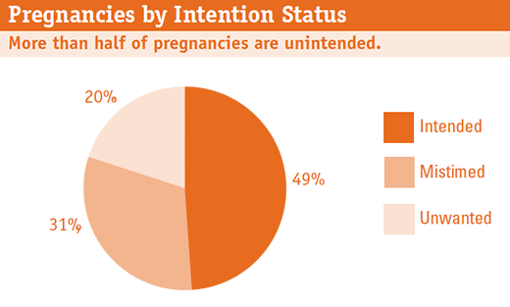
Why Preconception Health?
Guttmacher, Unintended Pregnancy in US, 2012

Slide 6
Evidence-Based Clinical Intervention
One Key Question®
“Would you like to become pregnant in the next year?”
An Initiative Created by Oregon Foundation for Reproductive Health

Slide 7
Yes
Refer to preconception care
Screen for conditions that can affect pregnancy
Medication review
Counsel on nutrition, exercise, substance use
Recommend folic acid daily
Recommend early prenatal care

Slide 8
No
Ask about current contraceptive use
Check satisfaction with current method
Offer contraception options
Offer emergency contraception

Slide 9
OK Either Way or Unsure
Ensure preparedness for a pregnancy
Recommend preconception counseling and early prenatal care
Offer a combination of contraception and preconception care
Discuss ambivalence and relevant issues
‘Act pregnant before you become pregnant’
Notes:
Remind that the use of contraception can help her prevent pregnancy until it is the right time
“Act Pregnant before You Become Pregnant” reminds your patient that her health before she becomes pregnant is important

Slide 10
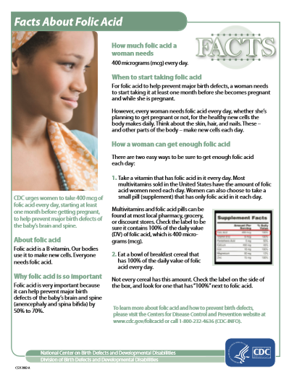
One Key Question ® Toolkit

Slide 11
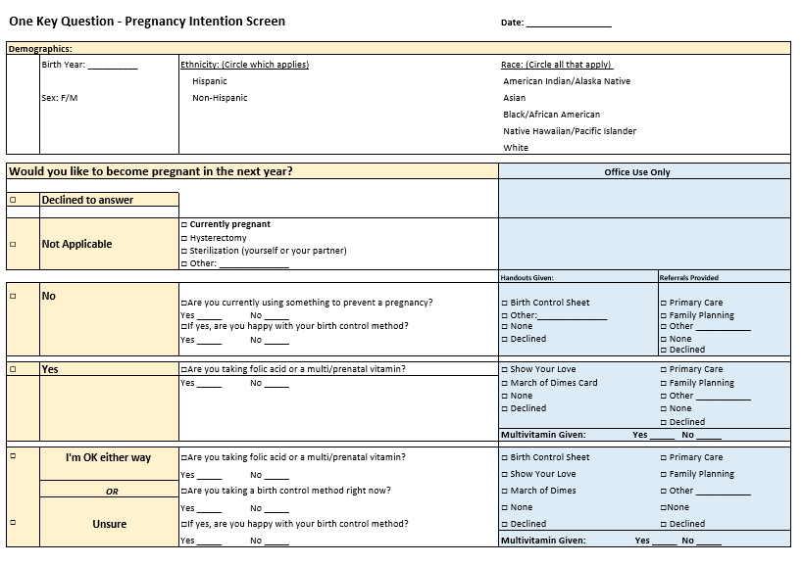
Notes:
removed: Used in WIC, Head Start, Home visiting -- this can be explained verbally.

Slide 12
Notes:
The information displayed has been well received by clients and providers and is one of the only presentations of the complete information by effectiveness. This also is printed with Spanish on the back. These are provided to clinics by HCCSO though the grant funds.

Slide 14
Outcome Measures to be Tracked
Unintended Pregnancy Rate
Contraceptive Use Rate
Teen Pregnancy & Birth Rate

Slide 15
Public Health Strategies:
Remove barriers to contraception:
Advocacy work to ensure all methods of Birth control are covered,
Improve availability and increase referrals for LARCs – Long-Acting Reversible Contraception:
Annual Contraceptive Update Training, including training in IUD & Implant Insertion
Create quality improvement processes for preconception & contraceptive care:
Use data to provide Quality Improvement regularly

Slide 16
Incentivized 2015 CCO Metric
“Effective contraceptive use among women at risk of unintended pregnancy”
Oregon is first in the nation to adopt a preventive reproductive health metric

Slide 17
Jackson & Josephine Co. WIC Data 1908 women screened Oct. 2014 – Apr. 2015 Would you like to become pregnant in the next year? No = 54% Yes = 8% OK either way = 7% Not Applicable = 33%

Slide 18
“No” does not want to become pregnant
Are you currently taking Birth Control? | Yes | 70%
 | No | 30%
If yes, are you happy with your birth control? | Yes | 80%
 | No | 20%
“Yes” wants to become pregnant
Are you taking folic acid or multi/prenatal vitamin? | Yes | 68%
 | No | 32%

Slide 19
“I’m OK Either Way” or “Unsure”
Are you taking folic acid or multi/prenatal vitamin? | Yes | 59%
 | No | 41%
Are you currently taking birth control? | Yes | 45%
 | No | 55%
Are you happy with your birth control method? | Yes | 93%
 | No | 7%

Slide 20
Overcoming barriers
“Will it be too time intensive?”
“We do so many screenings already!”
Notes:
OKQ is feasible at the Primary Care Visit, home visiting session, WIC appointment, dental appointment and acceptable to women- even at non reproductive health visits.
Only about 30% of women asked will need follow-up care.

Slide 21
ONE KEY QUESTION® OUTCOMES
At Community Health Clinics:
30% of women needed follow-up with contraception or preconception care
70% did not require any follow-up services
At Public Health Clinics:
60% of women were happy with their current method of contraception
23% received new contraception services
12% were given preconception care and advised to start folic acid

Slide 22
Implementation Sites
WIC Program
Family Planning
Head Start/Early Head Start*
Healthy Start of Southern Oregon*
Healthy Families of America*
Advantage Dental (expanding to all Oregon sites!)
FQHCs & Private Health Care Providers
*Includes Douglas County

Slide 23
Acknowledgements
Implementation Manual
Clinic and Staff inventory
Various algorithms for screening
Custom Consultations
Clinic Flow, Data Collection
Additional Trainings for providers and team
OKQ patient brochure & posters
Notes:
OFRH can provide custom consultations with your clinic to help determine the best way to incorporate OKQ into care.

Slide 24
Michele Stranger Hunter, Executive Director
Sharon Meieran, MD, JD, Co Medical Director
Julia Epstein, NP, Co - Medical Director
Hannah Rosenau, Senior Policy & Access Coordinator
info@onekeyquestion.org
Follow us on Facebook and Twitter: Oregon RH
www.onekeyquestion.org
Notes:
Next steps:
Identify champion clinics to start screening
Plan for training and education
Implementation

Slide 25
Maggie Sullivan, MPH, Executive Director
Aubra Johnson, Josephine County Preconception Health Coordinator
Martha Rivera, Jackson County Preconception Health Coordinator
Renee Greenwood, Program Manager, Healthy Start of So Oregon
www.hccso.org

